Slide 1

netcom bus booking system
Project Guide
Mrs. Prajakta Patil
Course Coordinator
Mr. Bhanu Pratap Singh
Name | PRN
DHOKRAT SHREEKANT (Team Leader) | 210930920013
CHINTHAKUNTA SOWMITRA | 210930920008
CHOURE PRAJAKTA | 210930920010
LANDGE AKSHAY | 210930920022
MAYURI KOTHAWADE | 210930920027
SHRIDHAR PATIL | 210930920047

Slide 2
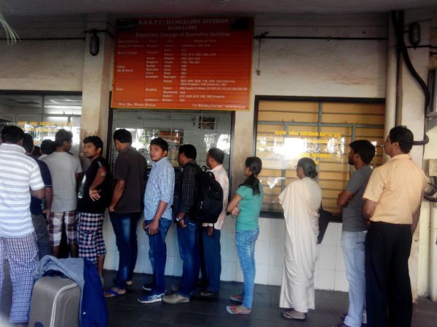
Online Bus Booking SYSTEM
Online Bus Booking System has become very easy these days.
Previously to book a bus ticket we have to stand in a long queue and book the ticket. Now that days have gone.

Slide 3
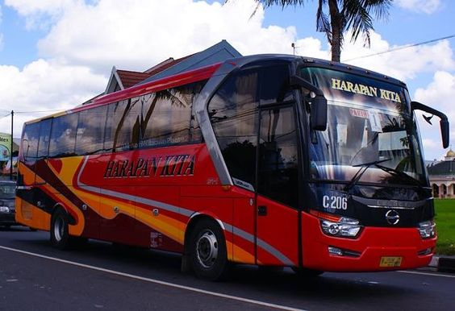
online bus BOOKINg system was not easy in india. But now because of internet AND USER FRIENDLY Websites, it has become easy to book the ticket online and pay ONLINE.

Slide 4
There are numerous travel agencies which provides bus booking such as
SRS Travels, KESARI Travels, VEENA Travels, LEENA Travels etc,
WHY THE NEED? You need to go Physically to their place taking time out of your busy schedule from work, to reserve a ticket, for which children and senior citizens had a major challenge to overcome.
Now FOR OUR COMPETITION websites like Makemytrip, Redbus have the facility to book tickets online, but there were concerns raised by people like

Slide 5

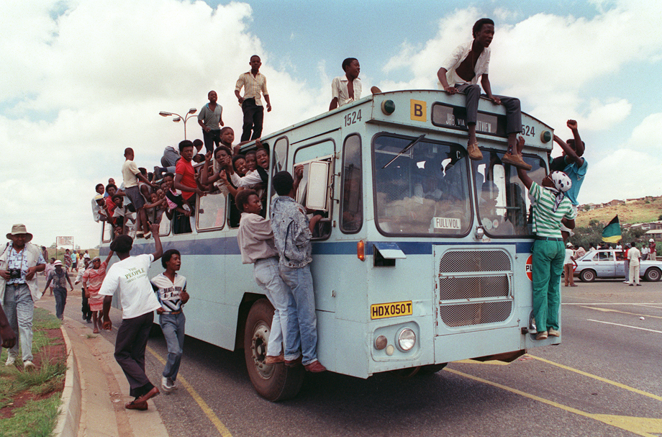
They showed us this
And we received this

Slide 6
And found only stable and best website as per public survey was

Slide 7
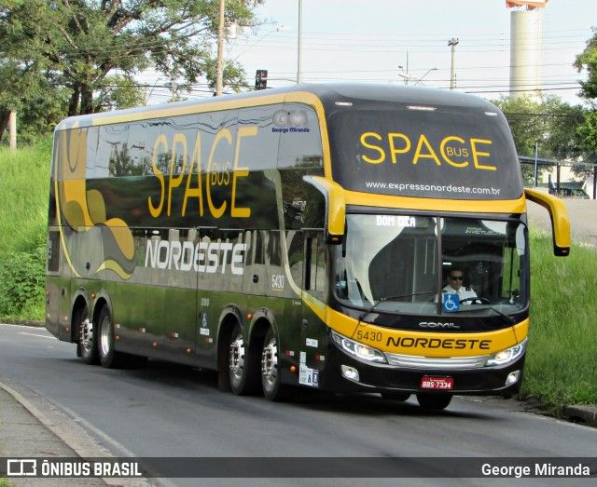
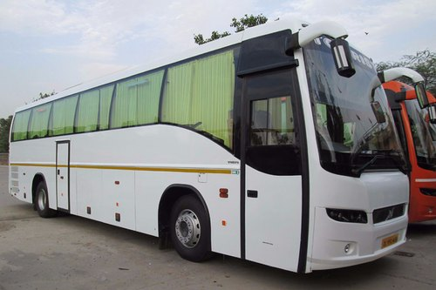
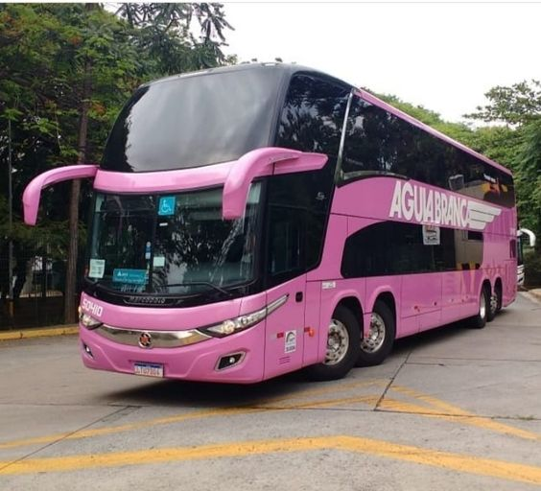
NETCOM BUS BOOKING SYSTEM - NBBS
Your one and only solution, for safe and luxurious travel
Bus Ek Baar Baithe ke toh Dekho !!!

Slide 8
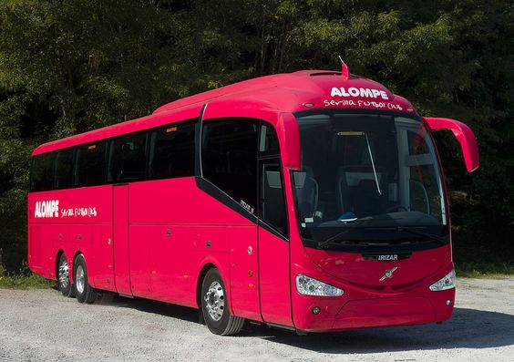
netcom bus booking system
But using
We got value for our money, they showed us exactly with what we will be travelling with

Slide 9
Process of Booking Online Ticket has never been so easy
The Process of Bus Booking is very Simple Using 5 easy steps:
Register if newly visited our website or Login using your credentials.
Choose your place and destination you wish to visit.
Choose the date of Journey.
Select the passenger seat of choice for travelling.
Book the ticket and Pay Online.

Slide 10
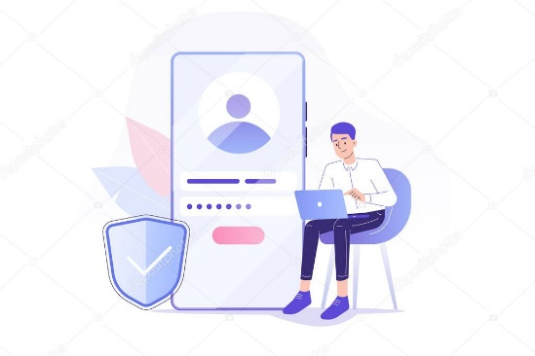

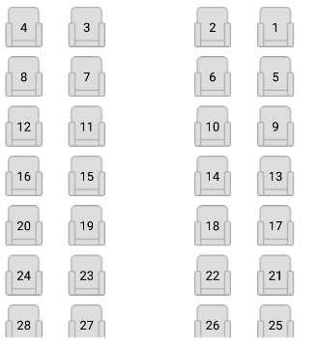
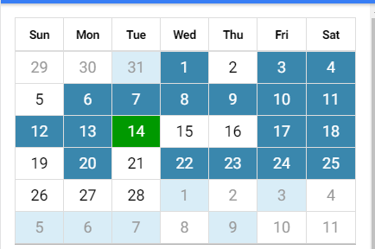
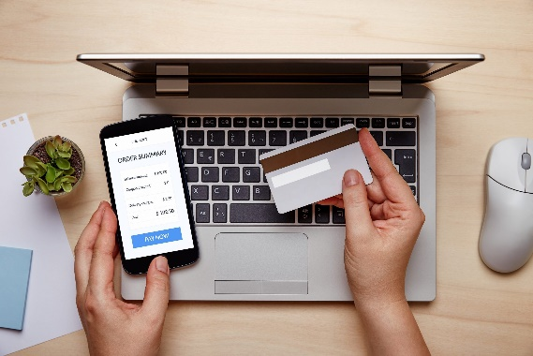

STEP 2: SELECT PLACE TO VISIT
STEP 1: REGISTER LOGIN
STEP 4: BOOK YOUR SEAT
STEP 3: SELECT DATE
STEP 5: PAY ONLINE
TRAVEL AND ENJOY

Slide 11
By Using Netcom Bus Booking System you can save your valuable time
Within the comfort of your home you can book your bus ticket.
3000 Travel Operators our available with us
24*7 Customer Service Provided (with Safety)
You can book ticket by using Netcom Bus Booking System throughout India
Online Bus Booking is made easy by using
Netcom Bus Booking System NBBS.com

Slide 12
For More Information
You can visit our website at
www.nbbs.com
You can contact us at: 8888888888
Visit our Facebook Page: facebook.com/netcombusbookingsystem

Slide 13
GREAT Founders of our nbbs
Name | PRN
DHOKRAT SHREEKANT (Team Leader) | 210930920013
CHINTHAKUNTA SOWMITRA | 210930920008
CHOURE PRAJAKTA | 210930920010
LANDGE AKSHAY | 210930920022
MAYURI KOTHAWADE | 210930920027
SHRIDHAR PATIL | 210930920047

Slide 14
WorkING roles AND RESPONSIBILITIES
Name | Working Roles
DHOKRAT SHREEKANT (Team Leader) | BackEnd
CHINTHAKUNTA SOWMITRA | BackEnd
CHOURE PRAJAKTA | FrontEnd
LANDGE AKSHAY | BackEnd
MAYURI KOTHAWADE | FrontEnd
SHRIDHAR PATIL | FrontEnd

Slide 15
Project Tech Stack and its usage
We used MySQL,JAVA EE, React JS for DATABASE AND FRONTEND DEVELOPMENT
Thank you

